Slide 1
Capstone Project Presentation
Jake Fitzgerald
C00288105

Slide 2
Presentation Overview
Overview of both project and technical snippets of code:
Design / Gameplay
MIDI Parser
Generating Block sections
Percentage of core completed

Slide 3
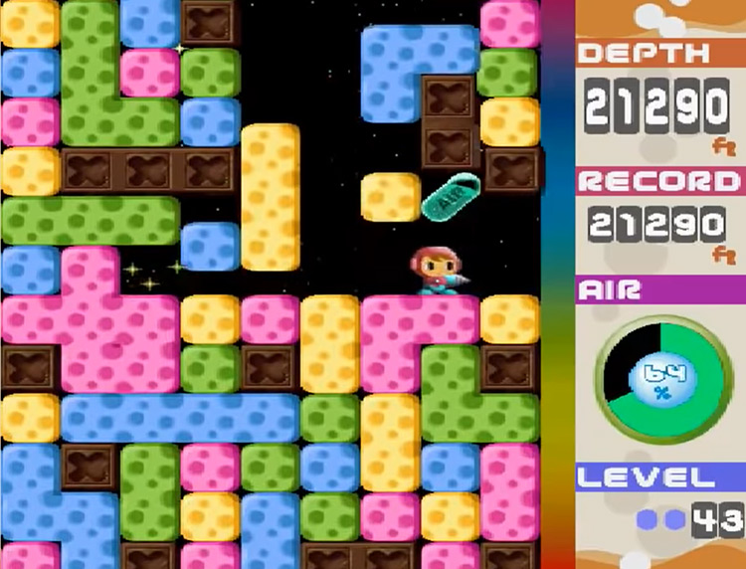
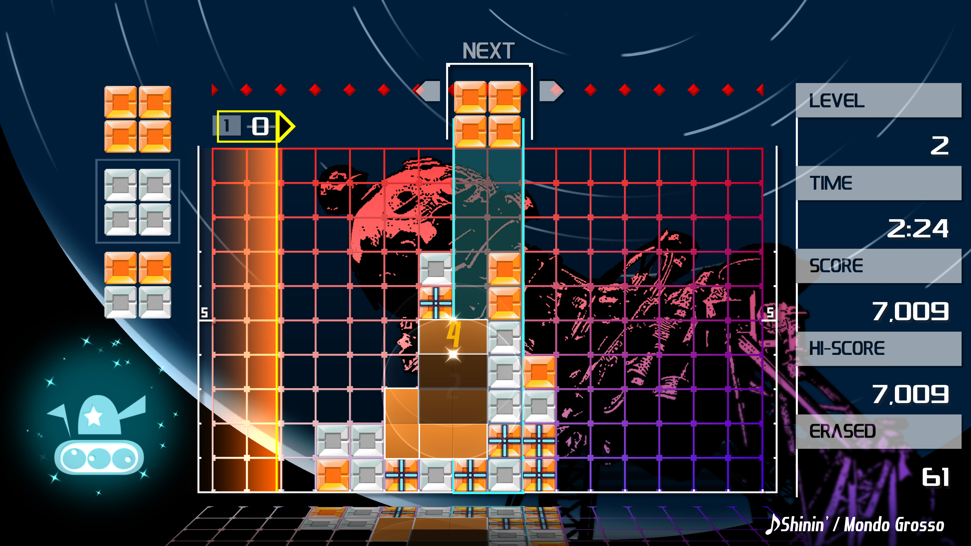

Gameplay / Design

Slide 4
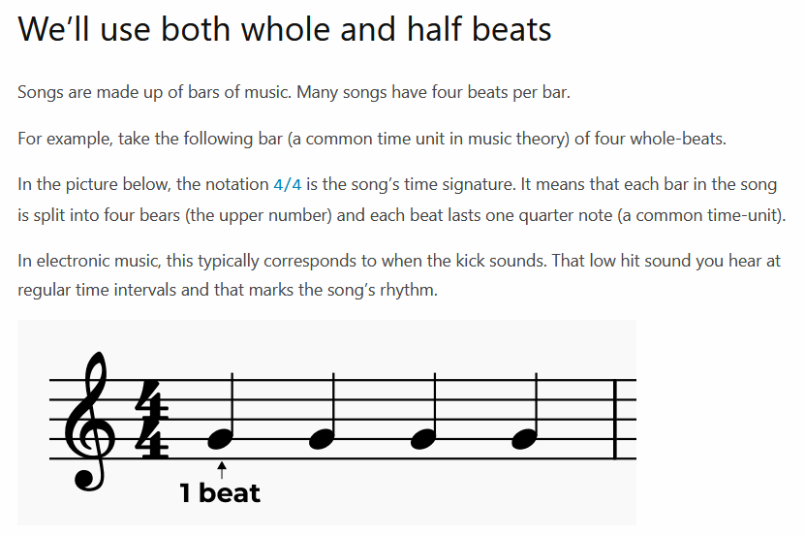

Slide 5
MIDI Parser
MIDI Parse – Header file
Covert from the older version of Big Endian to work with our current C++ code.
Parse out string data so that we can get our BPM, Channel Name, Time Signature
Calculate the distance between the notes. Use BPM, BPS and the time data where the note is stored in MIDI [MIN, SEC, MSEC].

Slide 6
Generating Block Sections
How Blocks are connected to one another (search algorithm)
MIDI data influence (BPM, BPS, etc)
Randomly Generated Sections with patterns (Merenne Twister, additional randomiser functions)
Generic Sections for balanced level flow (Health, Funnel Top/Bottom, Phase Transition, etc)

Slide 7
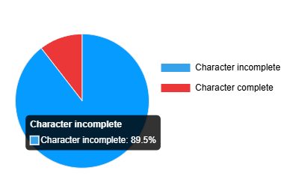
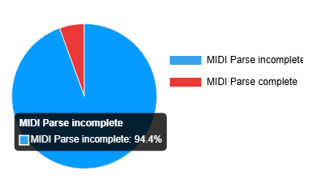
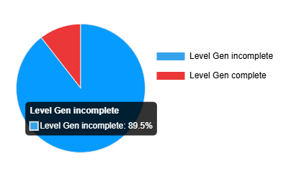
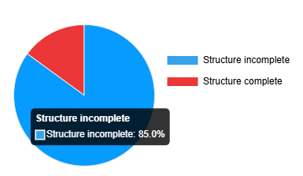
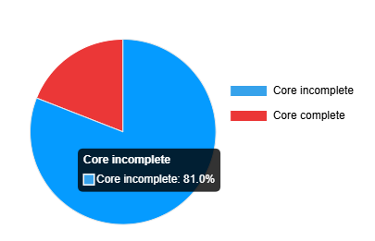
Pie Maps

